Slide 1
Final Report MGMT 6203
James Lee, Emma Coates, Nora Perotti, Liam Nguyen, Cassidy Lee

Slide 2
Overview
Overview of the Project
Sidel, Inc a global company HQ in France
Operates in 190 countries
HQ dictates stock levels (safety stock) for the various part categories
Part categories are ranked according to their turnover level, A, B, C, etc.
Background information
1st case study, evaluated if there is a need to limit the scope to overcome the curse of dimensionality when predicting late deliveries with ML-based regression models.
2nd case study, highlighted implementation challenges frequently faced in supply chain management and the effectiveness of using a clustering approach to classify items based on their importance.

Slide 3
Hypotheses
Late shipment of parts is related to incorrect ABC part categorization
Linear Regression to predict timeliness of order fulfillment.
Safety stock to be used as predictor
K-means to recreate the 3 categories based on demand
We expect some parts to shift from their category
Logit model to predict whether a part was delivered on time or not.
If the number of items in “A” increases, then it will be less likely to have on time deliveries (safety stock qty in this category is lower).
Notes:
Given that safety stocks are determined in part by ABC category and Sidel is plagued by late deliveries and rusting inventory, we hypothesize that the categorization of parts might be incorrect. We can check this assumption by using linear regression to predict the timeliness of order fulfillment. For our initial hypothesis to be true, safety stock would need to be a significant predictor.
Next, we can implement a k-means model to recreate the three categories based on demand for each part—median order size for a part, number of unique customers who order the part, and the number of unique orders containing the part. We expect that some parts will shift from their current ABC categorization.
Finally, we can implement a logit model to predict whether a part in an order was delivered on-time or not. If we include the recreated k-means categories as categorical predictors, we would expect that if the number of items in A increases, it will be the least likely to have on-time deliveries, as it would have the most parts with too-low safety stock that need to be reordered from HQ.

Slide 4
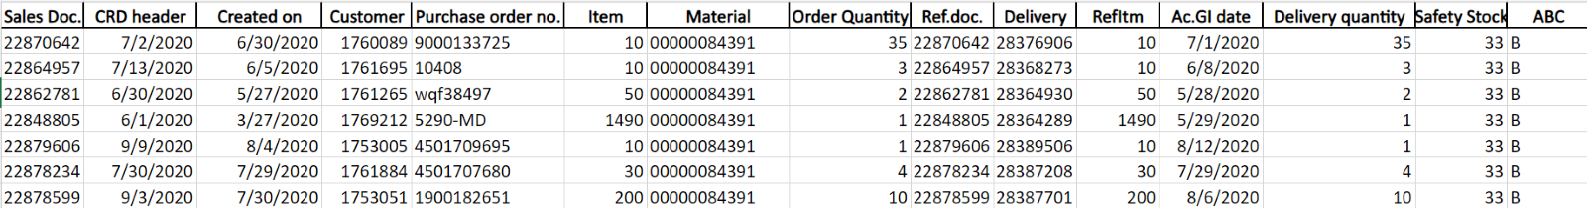
Overview of Data
Cleaning process
Data came from reports out of Sidel, Inc SAP system.
We gathered information pertaining the purchase and sale for all A, B, and C parts spanning 2019 to present
Four reports were pulled: the Sales orders, Purchase orders, safety stock, and the Delivery information report.
Joined the customers and deliveries data through Sales doc and Ref.Doc columns.
These datasets solidify a single comprehensive dataset to use for regression analysis and other models.
Final dataset is organized by material ID—with one row for each material ID on a given order.
Notes:
We used multiple reports from Sidel to create one dataset to use for modeling. These reports contained sales and delivery information that was used to calculate time between order and shipment.

Slide 5
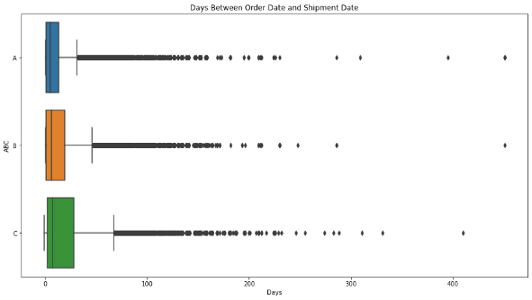
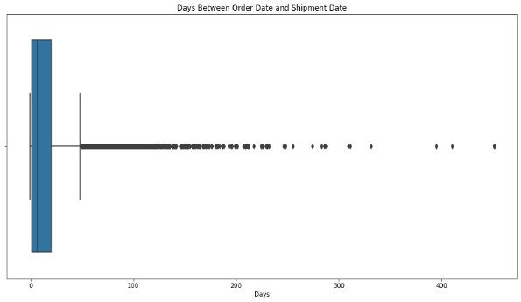
Analyzing the data
Distribution has outliers that may indicate delivery delays
Noticed that “C” parts take longer to ship compared to A and B parts
Average of order intake indicate some seasonality.
Investigated part categorization, rusting parts suggested excess of stock
Parts not evenly spread between each category
Notes:
We can see that this distribution is skewed with several outliers. These outliers may indicate issues with the parts like availability that may cause their delivery to be delayed for more than a year. We can also see the distribution by part categorization:
Aside from the outliers, C parts take a bit longer to be shipped compared to A parts, which take the least amount of time.

Slide 6
Data Insight
Data: 141K rows spread over 11 columns
Key Variables:
Response Variables
Time measured by days between the CRD header to actual date when Sidel fulfills customers PO
For the logit model will create an additional column indicating- “0” if late or “1” if on-time or early.
Exploratory Data Analysis
Parts classified as “C” the parts the ones that have the lowest safety stock
Each category has roughly 2.5 times the number of materials than the previous category.
Customer Requested Dates (CRD) | Delivered quantities
Ordered quantities | ABC Category
Safety stocks | Shipment dates
Notes:
Overall, these were the variables we had selected for use in the models, with response variables for both linear and logistic regression. The logistic regression response is coded as 0 for late, 1 for not late.

Slide 7
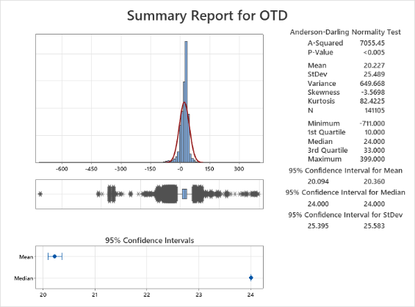
Modeling
Overview
Graph shows the distribution of all 3 categories combines.
For the model selection, we decided to start with a linear model- to determine on-time shipping
Response variable- OTD (on time delivery) column was created.
OTD- difference between CRD (customer request date) and shipment date.
Positive OTD- shipment ahead of CRD
Negative OTD-shipment behind of CRD
“0” OTD-shipment on time per CRD
Notes:
For categories of ABC items, graphical summaries show OTD distributions with mean on the positive sides (meaning on average, orders are shipped either on-time or early). However, the standard deviations are larger than the means, so there are lots of late shipments, as can be seen when viewing the boxplots.

Slide 8
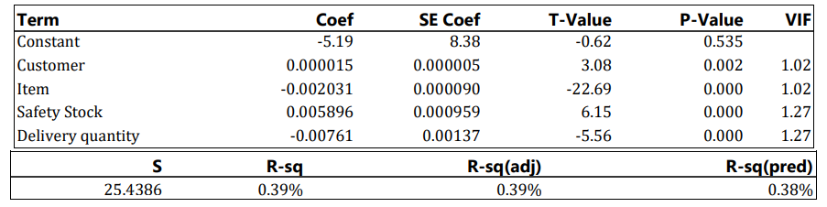
Modeling
Linear Regression Model
Used 10-fold cross validation with forward stepwise selection- to explain the relation of dependent and independent variables.
Intercept -5.19- Sidel was already behind CRD when PO was submitted
P-value is not significant
Model shows relatively healthy R-square to demonstrate goodness of fit—it explains approximately 39% of the variability in our response.
Coefficients- they are small, yet significant since their p-vales are less than 0.05.
Delivery quantity - largest coefficient at -.008.
Safety stock has the next largest coefficient at .006.
OTD | = | -5.19 + 0.000015 Customer - 0.002031 Item + 0.005896 Safety Stock - 0.00761 Delivery quantity

Slide 9
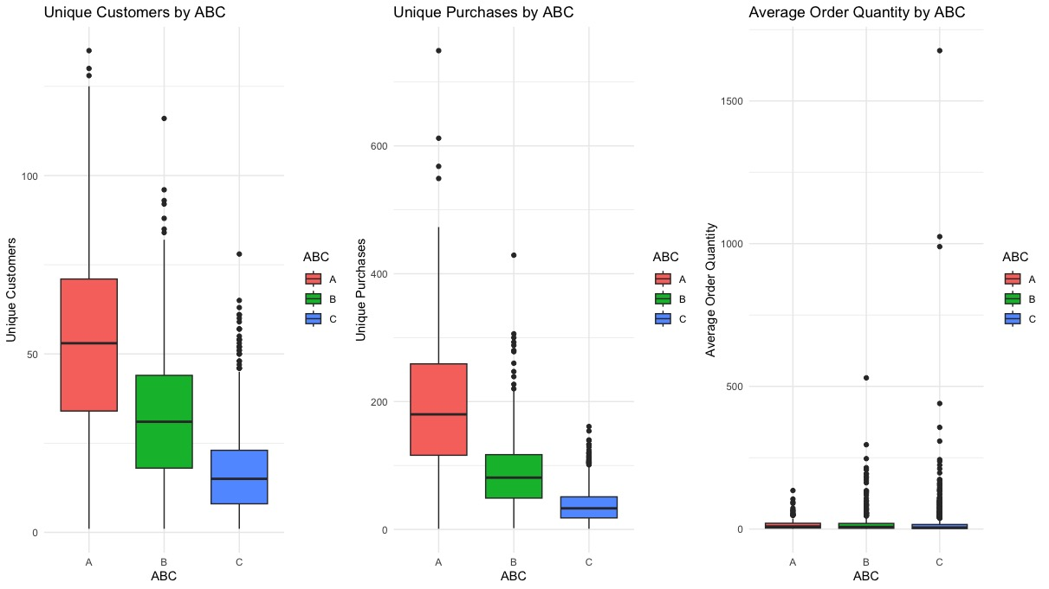
K-means
Group the data into distinct A, B, and C categories
Boxplot: unique customers, purchases, and quantities ordered
Lots of outliers and overlap
Seems that each category has about 2.5X the number of materials in the previous category
In EDA, the quantity ordered increases with each successive category.
We do not know how the company chose the size ratio between the A, B, and C
Notes:
As seen on the 3 plots below, several outliers were found in the three-part categories.
No access to price data, so the demand/importance metrics we used for clustering were.
This suggests that what we anticipated in out initial hypothesis regarding the size of the categorization of parts might be incorrect. In addition, it is very clear the quantity of parts purchased to stock at Sidel, Inc in Georgia are not equal, being parts classified as “C” the parts the ones that are order the most quantity. It seems each category has roughly 2.5X the number of the materials in the previous category.

Slide 10
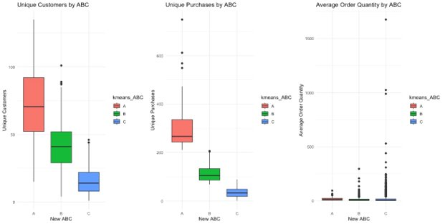
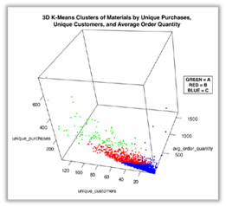
K-means
After K-means clustering
Fewer outliers and less metric overlap between A, B, and C.

Slide 11
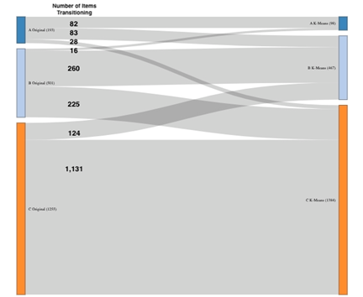
K-means
New clusters were about 24.42% different from Sidel’s original groupings.
Logistic regression model may not clearly show an effect from incorrect ABC categorization
Notes:
Finally we created a sankey plot to see how the parts transitioned.

Slide 12
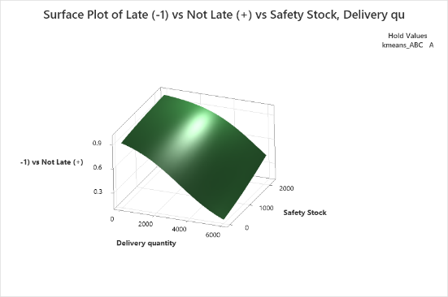


Logistic Regression
Model Summary and graph:
Model used to help predict and explain independent variables impact to the dependent variable (OTD).
OTD is positively correlated with safety stock and negatively correlated with quantities for delivery.
AUC is 0.54 (greater than 0.5)-AUC shows the model can predict OTD at a better rate than random chance.
Coded coefficients:
Deviance R-Sq | Deviance R-Sq(adj) |  | AIC | AICc | BIC | Area Under ROC Curve | Test Deviance R-Sq | Test Area Under ROC Curve
0.03% | 0.03% |  | 60587.56 | 60587.56 | 60616.07 | 0.5423 | 0.03% | 0.5398
Term | Coef | SE Coef | Z-Value | P-Value | VIF
Constant | 0.977 | 0.546 | 1.79 | 0.073
Delivery quantity | -2.053 | 0.606 | -3.39 | 0.001 | 1.25
Safety Stock | 0.753 | 0.190 | 3.96 | 0.000 | 1.25
Notes:
All three-plots show that with large quantities to deliver and safety stock being small, the probability of CRD being on time or early reduces. As seen by the model, the probability of OTD is positively correlated with safety stock, and negatively correlated with quantities for delivery. In addition, the AUC is 0.54 (greater than 0.5), we know that the closer the AUC is to “1” the better the performance of the model will be at distinguishing good OTD (on time delivery) performance. The AUC here shows that our model can predict OTD at a better rate than random chance.

Slide 13
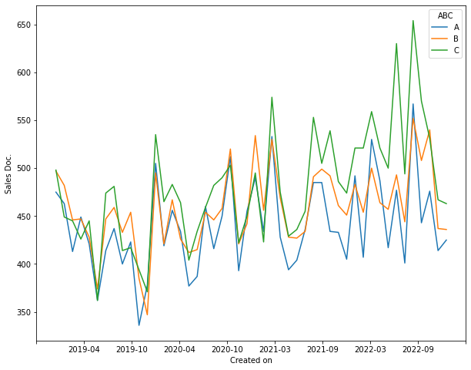
Conclusion
Our k-means hypothesis was correct- Many parts shifted categories
Cannot make recommendations since we do not know HQ cutoffs for safety stock
Parts “C” take longer to ship than “A” and “B” parts.
Peak seasons for Sidel happened during 1st Q and 4th Q
The models confirm some parts are in the wrong category:
Stock replenishment is not happening on time (safety stock might be wrong)
Likely causing CRD delays
Notes:
We believe that Sidel has parts that are in the wrong category, which might be the reason for not ordering the parts on time and not meeting CRD.
If we had more time, we would have liked to test the inclusion of an interaction term between ABC category and safety stock in our models. This would give us more information about the relationship between ABC category and when an order is delivered.
Our k-means categories could be implemented by the company, which would correct safety stock levels—in turn, reducing waste from overstocked parts and ensuring parts with high demand don’t go on backorder. Ultimately, this would save money for the company and improve customer satisfaction with delivery efficiency

Slide 14
Works Cited
Jayantakut. “AI/ML Use Cases for Supply Chain Management (SCM).” Analytics Vidhya (blog), June 24, 2022. https://www.analyticsvidhya.com/blog/2022/06/ai-ml-use-cases-for-supply-chain-management-scm/.
Steinberg, Fabian, Peter Burggräf, Johannes Wagner, Benjamin Heinbach, Till Saßmannshausen, and Alexandra Brintrup. “A Novel Machine Learning Model for Predicting Late Supplier Deliveries of Low-Volume-High-Variety Products with Application in a German Machinery Industry.” Supply Chain Analytics 1 (March 1, 2023): 100003. https://doi.org/10.1016/j.sca.2023.100003.

Slide 15
Linear Regression
Used 10-fold cross validation with forward stepwise selection- to explain the relation of dependent and independent variables.
Intercept -5.19- Sidel was already behind CRD when PO was submitted
P-value is not significant
Model shows relatively healthy R-square to demonstrate goodness of fit—it explains approximately 39% of the variability in our response.
Coefficients- they are small, yet significant since their p-vales are less than 0.05.
Delivery quantity - largest coefficient at -.008.
Safety stock has the next largest coefficient at .006.
Linear Regression
OTD | = | -5.19 + 0.000015 Customer - 0.002031 Item + 0.005896 Safety Stock - 0.00761 Delivery quantity

Slide 16
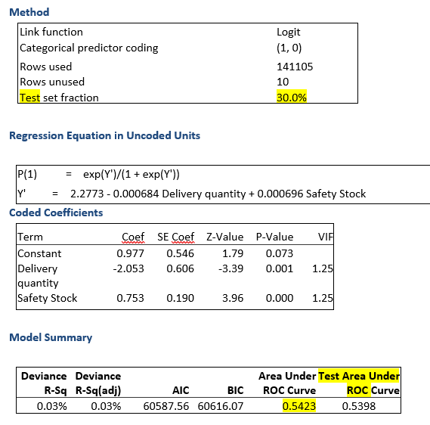
Logistic Regression
From logistic regression, the surface plot shows that with large quantities to deliver and safety stock being small, the probability of CRD being on time or early reduces. As seen by the model, the probability of OTD is positively correlated with safety stock, and negatively correlated with quantities for delivery. In addition, the AUC is 0.54 (greater than 0.5), we know that the closer the AUC is to “1” the better the performance of the model will be at distinguishing good OTD (on time delivery) performance. The AUC here shows that our model can predict OTD at a better rate than random chance.

